Slide 1
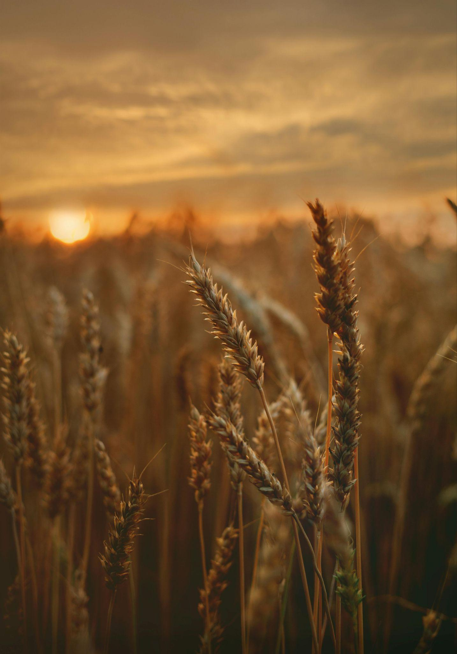
SmartFarm: IoT & Machine Learning for Farm Crop Yield Prediction
Final Presentation
COMPE510 - Fall 2025
Undergraduate Team 3: Daniel Self, Ulises Urbina, Brandon Nguyen
Notes:
Daniel

Slide 2
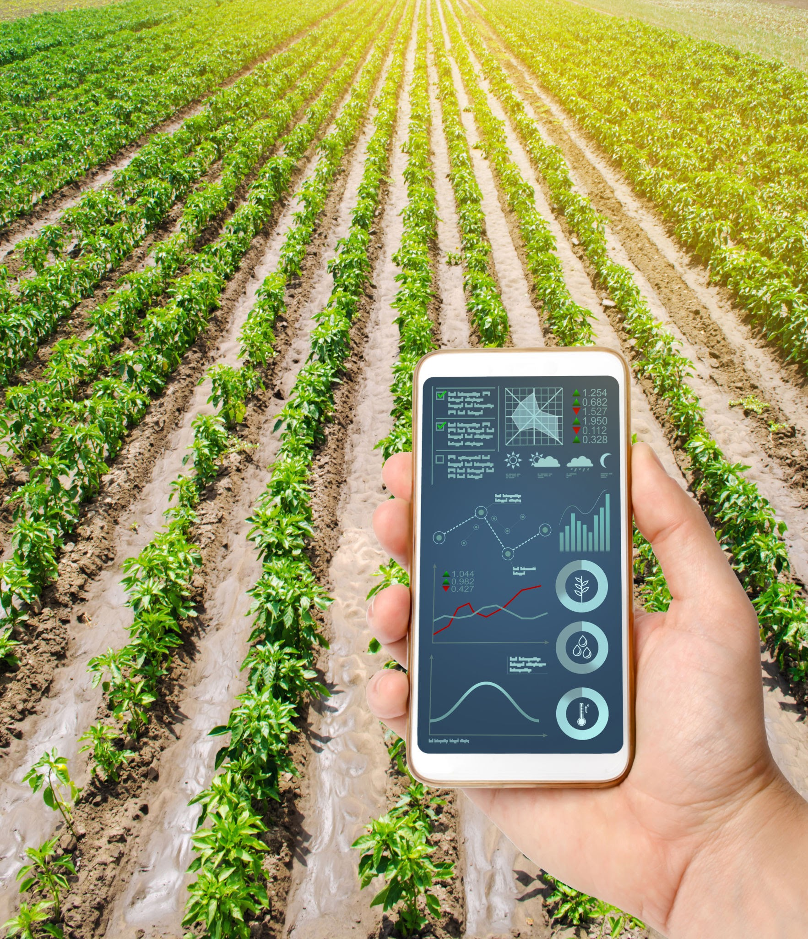
Introduction
Prompt:
Identify a real-life engineering problem that can be solved by machine learning and an associated dataset
Perform machine learning tasks, such as classification and regression etc., to the datasets, and report our results and observations
Each team member must implement a new machine learning algorithm that has not been discussed in class and also develop a GUI application
Chosen Algorithms:
eXtreme Gradient Boosting (XGBoost)
K-Nearest Neighbors (KNN) Regression
Support Vector Regression
Main Datasheet:
Smart Farming Sensor Data for Yield Prediction via Kaggle
Notes:
Daniel

Slide 3
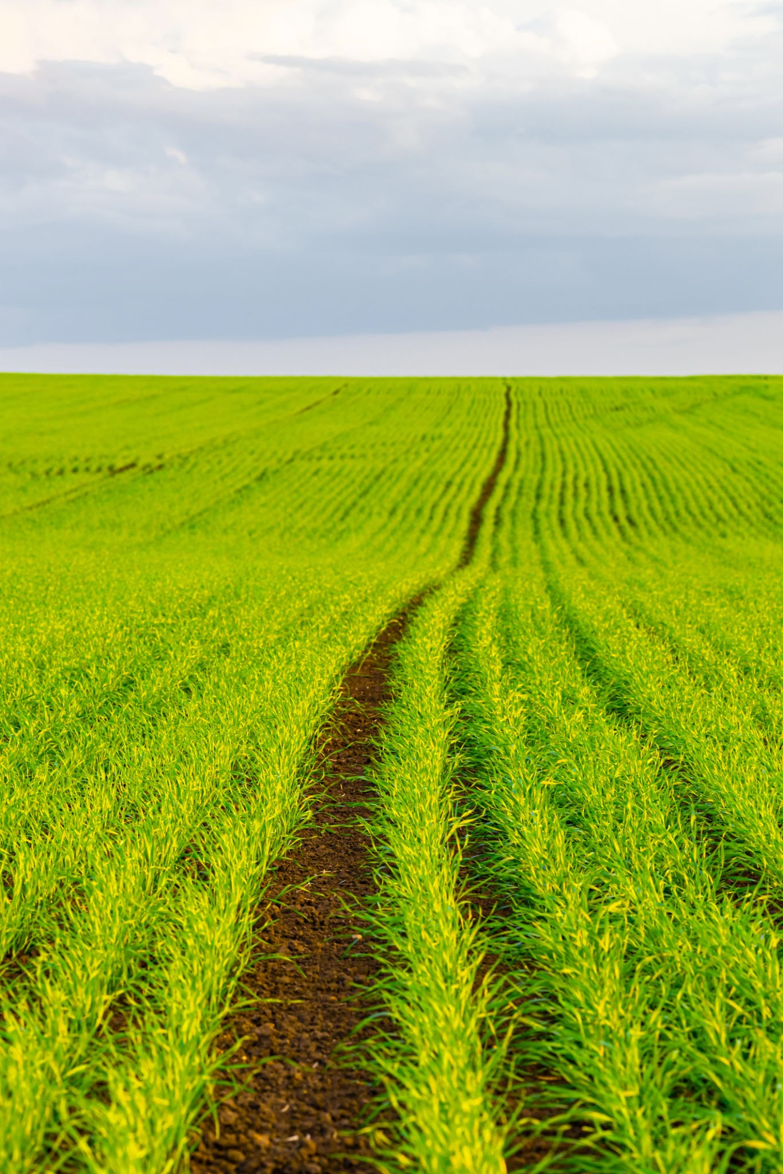
Introduction (Cont.)
Problem:
It is difficult for farmers to forecast how much crop yield will be produced when there are many factors affecting crop growth.
Solution and Purpose:
Collect data across a wide range of environments using IoT sensors and satellite data, and train a machine learning algorithm on that data to predict crop yield.
Desired Outcome and Goals:
A working predictive algorithm trained on sensor and satellite data
Functional web/GUI program for users to input their data
Users will receive prediction results based on their data
Notes:
Daniel

Slide 4
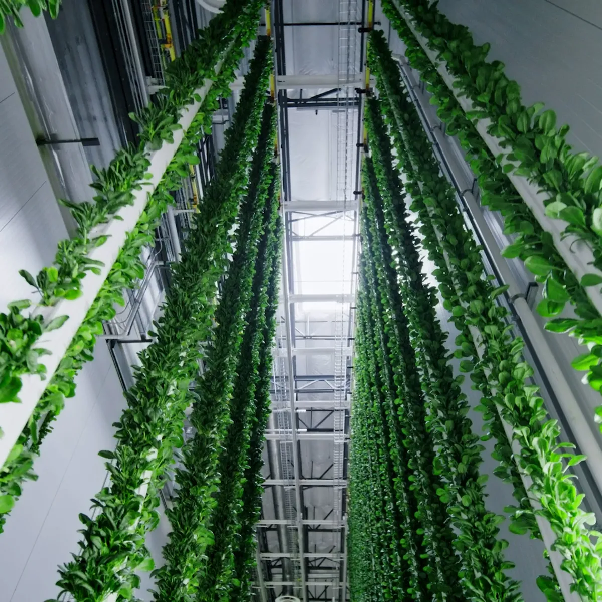
Related Work
We examine SVR, XGboost, K-NN – topics NOT covered in this class
Prior smart agriculture studies use ML for irrigation optimization, soil-moisture prediction, crop-disease detection, and yield forecasting
Kernel Based models (SVR) frequently appear in environmental prediction tasks to handle non-linear relationships
XGboost is widely used due to strong performance on noisy data
KNN commonly used as a simple baseline for models for similarity-based prediction
Many studies highlight the need for preprocessing, noise handling, and reliable sensor data pipelines.
Notes:
Brandon

Slide 5
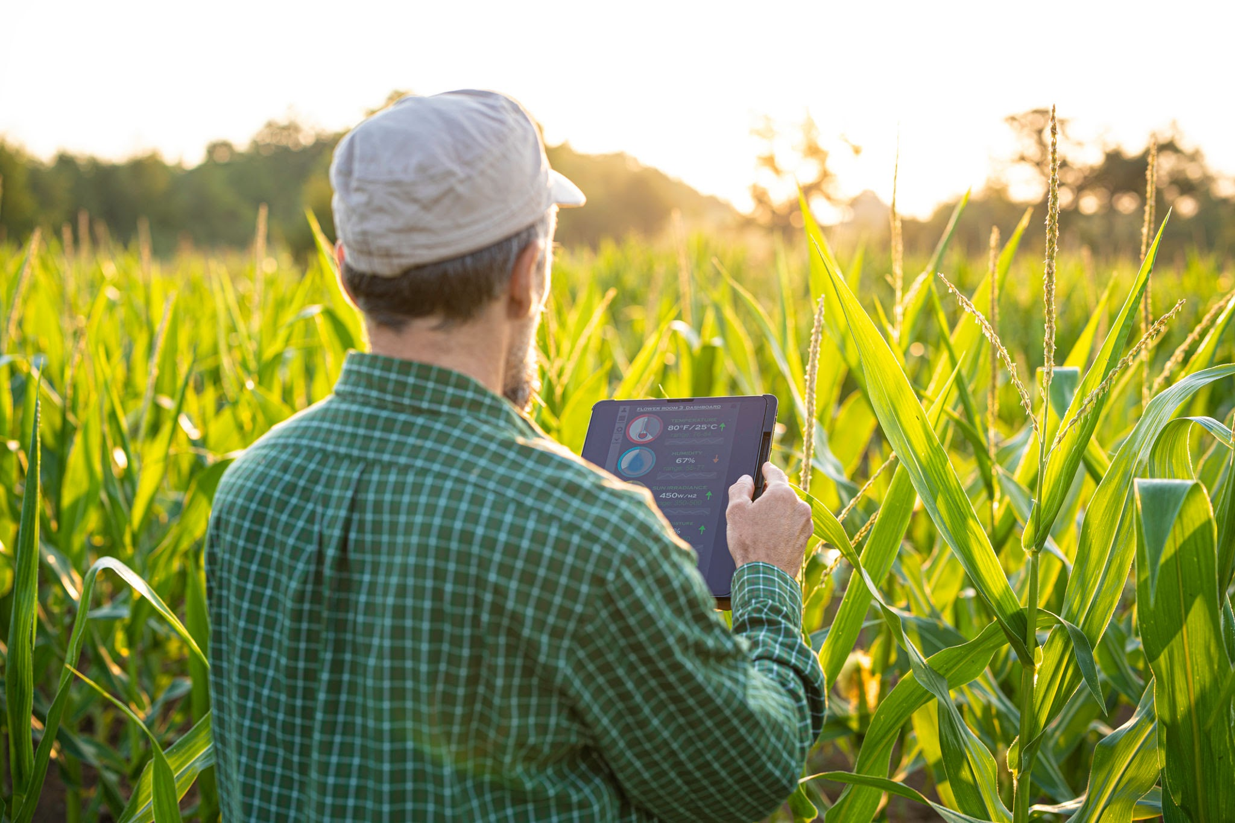
Problem Formulation
Modern smart farmers rely on sensor data to monitor soil moisture, temperature, and plant-health conditions
These environmental patterns are highly non-linear, noisy, and vary across regions
Farmers need accurate predictions to guide irrigation, resource allocation, and yield planning
Our project aims to build a predictive regression model that can learn from global historical sensor data, handle environment variability, generate reliable forecasts that support better farming decisions.
Notes:
Brandon

Slide 6
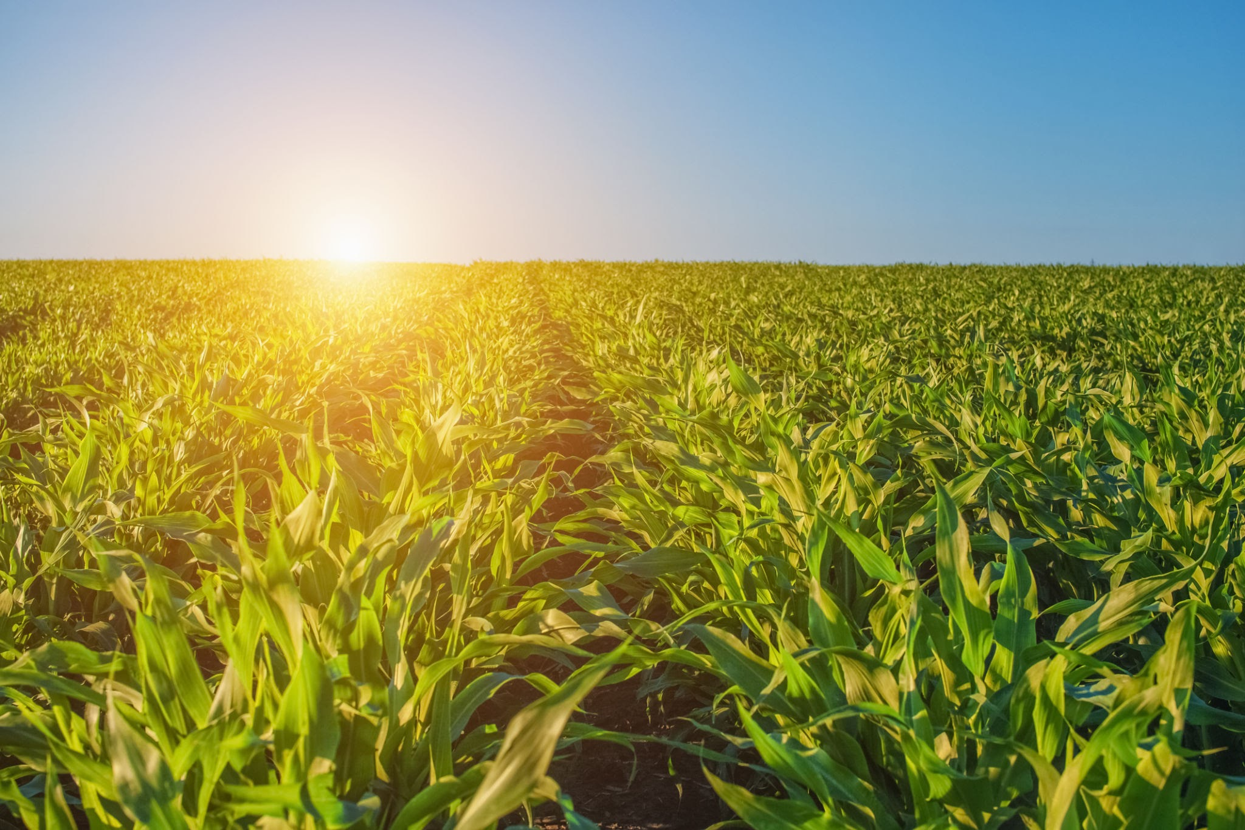
Methods
We examine SVR, XGboost, KNN - topics NOT covered in this class
These algorithms implement kernel based, ensemble based, and distance-based learning approaches
SVR:
Captures non-linear relationships
Performs well with continuous sensor data, and small-medium datasets
XGboost:
Handles noisy, heterogeneous data efficiently
Excels at modeling complex features in tabular datasets
Highly scalable, used frequently in industry
KNN:
Simple interpretable similarity-based model
Useful baseline to compare against more complex methods
Notes:
Brandon

Slide 7

Data Description & Experimental Setup
Data Description:
Dataset sourced from global smart-farm sensors across multiple countries.
Contains continuous environmental features: soil moisture, temperature, humidity
Several thousand observations with natural variation due to climate, geography, and sensor quality.
Experimental Set-up:
Implemented three regression models: SVR, KNN, and XGboost
Performed hyperparameter tunings
Evaluated models using MAE, MSE, R²
Notes:
Ulises

Slide 8
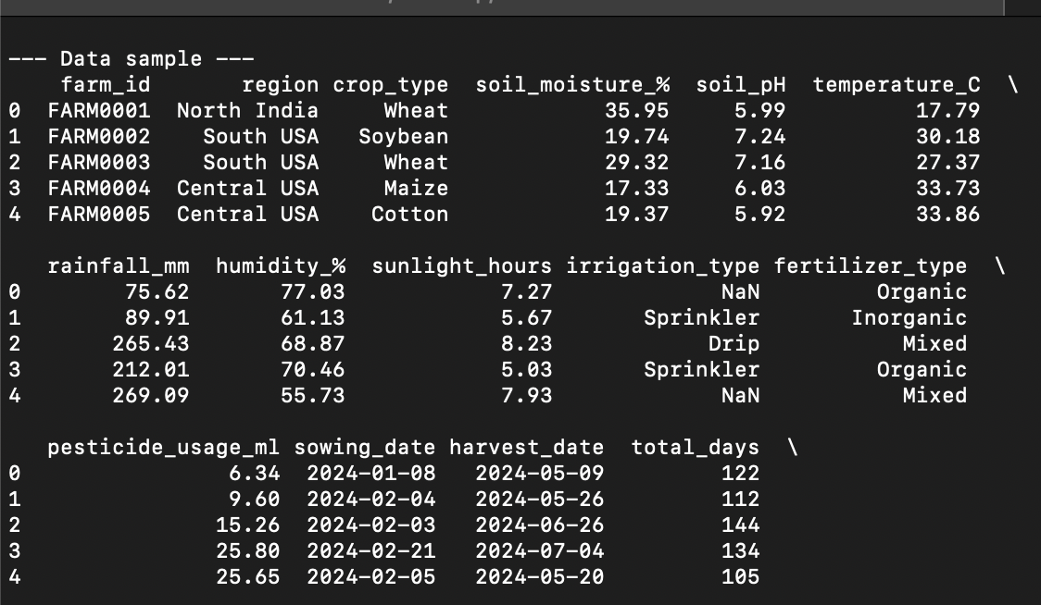
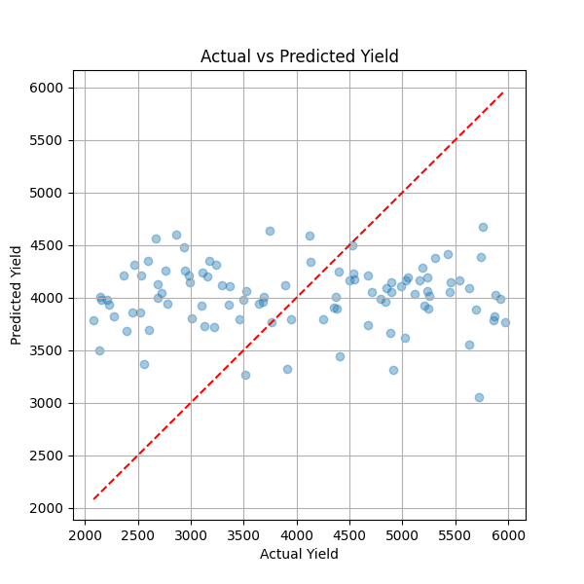
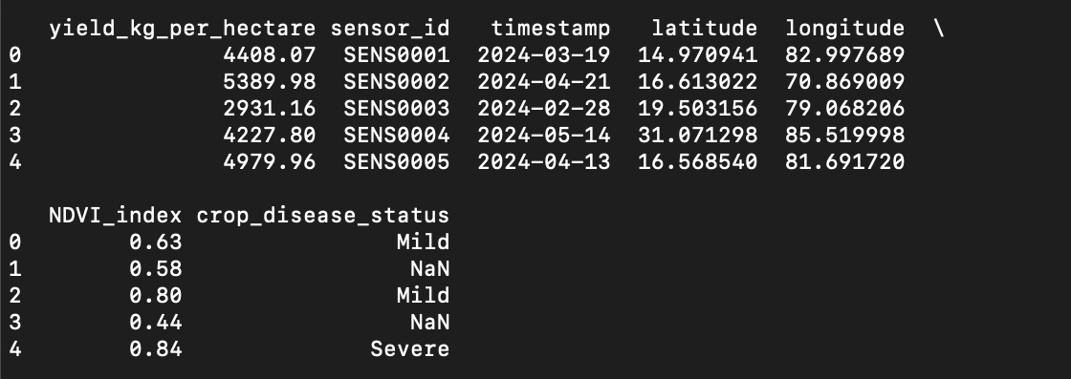
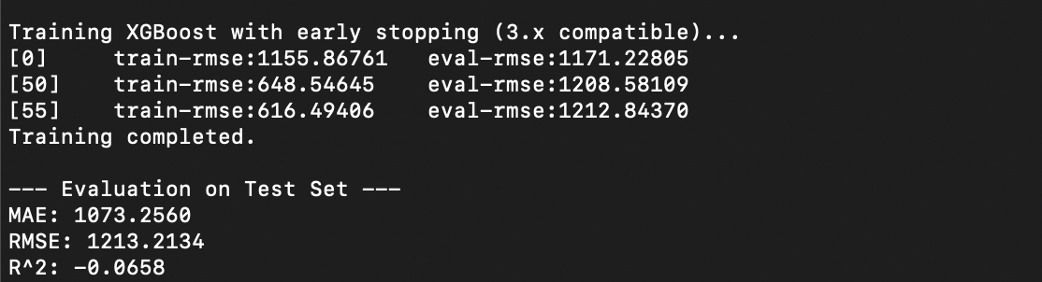
XGBoost Results
Notes:
Ulises

Slide 9
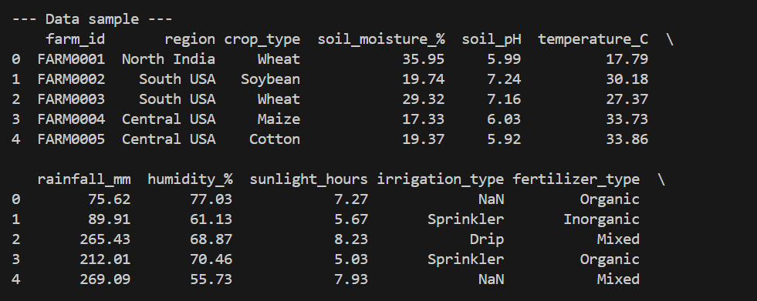
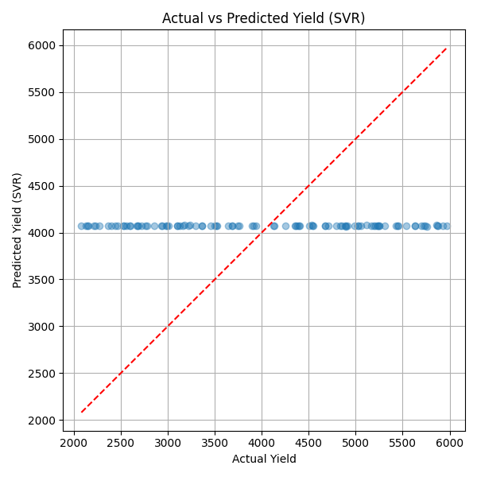
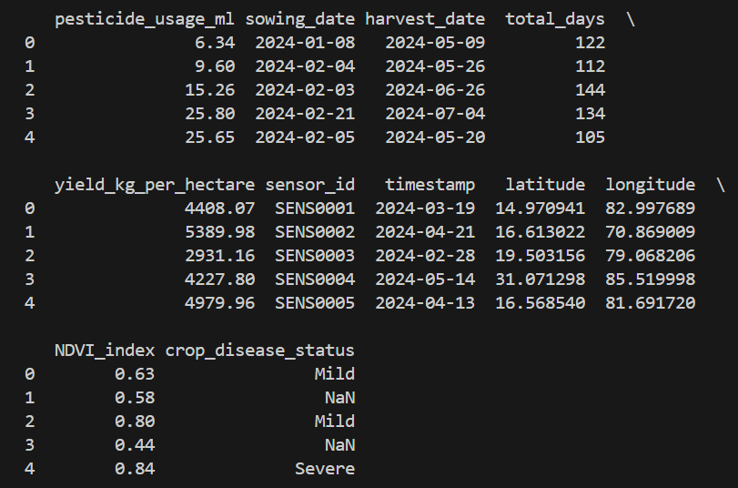
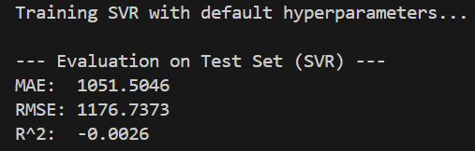
SVR Results
Notes:
Ulises

Slide 10
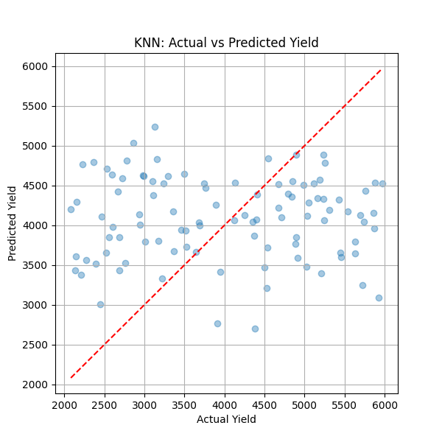
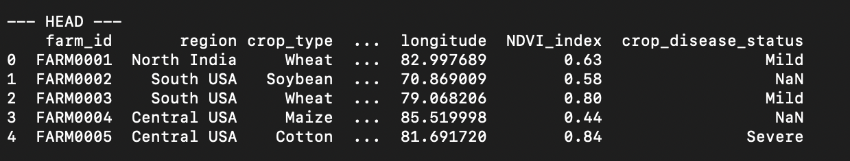
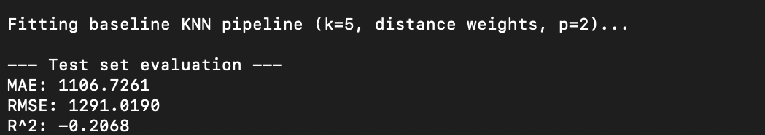
KNN Results
Notes:
Ulises

Slide 11
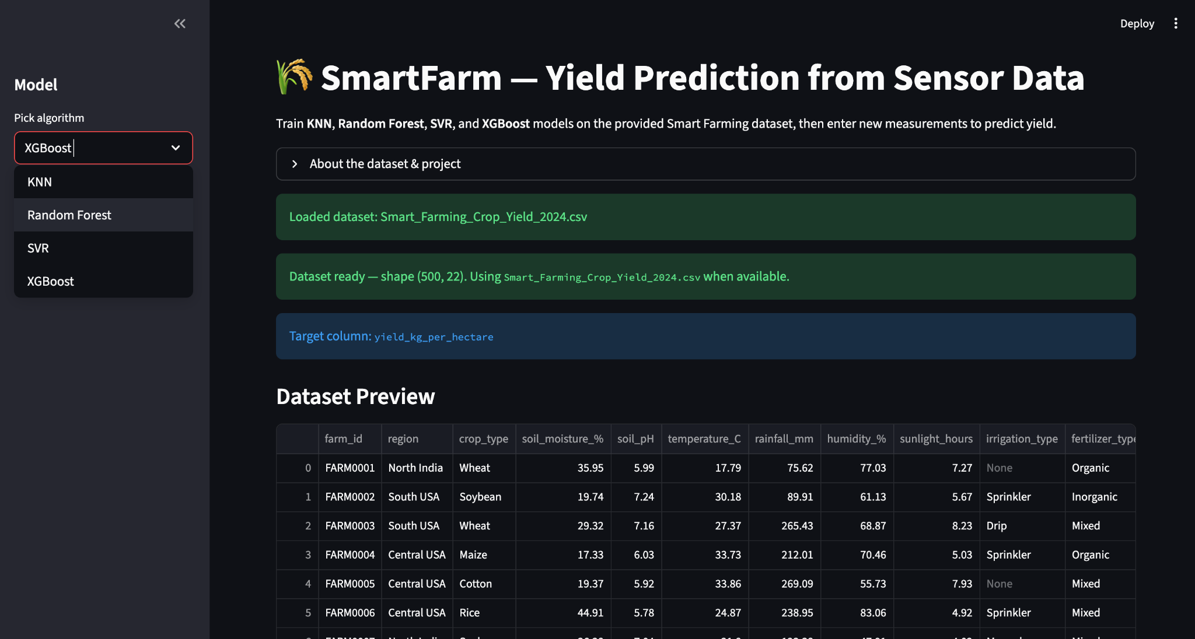
Application and User Interface
Link to Application and User Interface
Notes:
Daniel

Slide 12
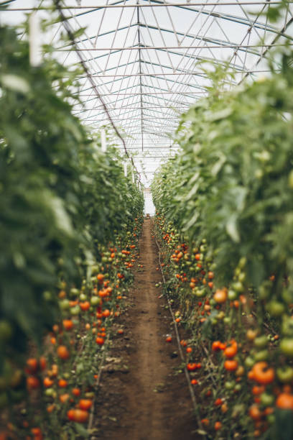
Conclusion
Result:
Demonstrates how machine learning models can be applied to smart-farm sensor data to support precision agriculture
Product:
Developed predictive models that estimate important environmental variables and assist farmers with data-driven decision-making
Project highlights the value of machine learning in enhancing agricultural efficiency and intelligent monitoring systems
Gained experience and implemented programs for new machine learning algorithms that were not discussed in class
Notes:
Daniel

Slide 13
Video Demo
Link to Final Presentation and Demo Video
Link to All Project Files on Github Repository
Notes:
Daniel

Slide 14
Reference
Soundankar, Atharva. “🌾 Smart Farming Sensor Data for Yield Prediction.” Kaggle, 15 Apr. 2025, www.kaggle.com/datasets/atharvasoundankar/smart-farming-sensor-data-for-yield-prediction.
“Understanding Support Vector Machine Regression.” MATLAB & Simulink, www.mathworks.com/help/stats/understanding-support-vector-machine-regression.html. Accessed 4 Dec. 2025.
“XGBoost Documentation.” XGBoost Documentation - Xgboost 3.1.1 Documentation, xgboost.readthedocs.io/en/stable/. Accessed 4 Dec. 2025.
“XGBoost.” GeeksforGeeks, GeeksforGeeks, 24 Oct. 2025, www.geeksforgeeks.org/machine-learning/xgboost/.
“K-Nearest Neighbor(KNN) Algorithm.” GeeksforGeeks, GeeksforGeeks, 23 Aug. 2025, www.geeksforgeeks.org/machine-learning/k-nearest-neighbours/.
“Support Vector Regression (SVR) Using Linear and Non-Linear Kernels in Scikit Learn.” GeeksforGeeks, GeeksforGeeks, 6 Aug. 2025, www.geeksforgeeks.org/machine-learning/support-vector-regression-svr-using-linear-and-non-linear-kernels-in-scikit-learn/.
Notes:
Daniel

Slide 15
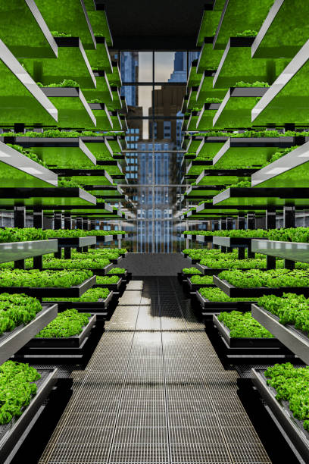
Individual Contributions
For the semester term project, our group believes that the workload was evenly divided among each member. As stated in the introduction, each team member must implement a new machine learning algorithm that has not been discussed in class and also develop a GUI application as one of the requirements of this term project.
Summary:
Brandon Nguyen: XGBoost algorithm (main), K-Nearest Neighbor Regression (help), Final Report and Slide Presentation
Daniel Self: K-Nearest Neighbor Regression (main), GUI Development (main), Final Report and Slide Presentation
Ulises Urbina: Support Vector Regression (main), GUI Development (help), Final Report and Slide Presentation
Notes:
Daniel

